Slide 1


Academic Support
of JROTC
Instructors
RTG & Associates
Jim Gomez
1-210.552.0759
rtgap2020@gmail.com
1

Slide 2
JROTC INSTRUCTOR UNIVERSITY CREDITS
YOUR NEEDS
Directorate Required Education
College Degree Licensure Support
Elective Credits
Pay Raise
Utilization of Benefits
Minimal impact on
Instructional Duties
Additional tax-free income
while enhancing your
teaching credentials
JROTC OPPORTUNITIES
15 credits for DOD required
certification courses (5 DL)
6 credits for NIOT and
Certification Training
15 additional credits
for other JROTC
Directorate or optional
school district in-service
training experiences
2

Slide 3

JROTC INSTRUCTOR CREDITS
Five DOD DL Courses for Certification
taken pass/fail at this link:
https://www.leadershipcredit.info/dod-jrotc-certification/
Educational Psychology
Classroom
Management
Secondary
Methods
Contemporary American Education
Learning
and the
Brain
3
Notes:
Key on effectiveness of instructors in writing assignments to their classroom.

Slide 4

https://www.leadershipcredit.info/dod-jrotc-certification/

Slide 5
JROTC INSTRUCTOR CREDITS
Distance Learning Process
for DOD Certification and
subsequent optional College Credit
On-line Effort
5 DOD DL Courses
Certificate of Completion
(minimum requirement for Directorate submission)
Certificate &
Writing Assignment (for college credit)
Emailed Submission to Professor
Grade
&
Transcript
5
Notes:
Key on effectiveness of instructors in writing assignments to their classroom.

Slide 6
Unique North Carolina Instructor Requirements
Undergraduate Courses:
  TECS 290 Intro to Instructional Technology
  PSY 670 Educational Psychology
  AEP 674 Secondary Methods
Graduate Courses:
  AEP 800 Intro to Utilization of Technology in the Classroom
  AEP 821 Educational Psychology
  AEP 823 Secondary Methods
6

Slide 7
Unique Kentucky Instructor Support
Undergraduate Courses:
  PSY 670 Educational Psychology
  AEP 670 Contemporary American Education
  AEP 675 Learning and the Brain
  TEEL 231 Human Growth and Development
  TEEL 350 Curriculum and Assessment
Graduate Courses:
  AEP 821 Educational Psychology
  AEP 824 Learning and the Brain
  AEP 670(g) Contemporary American Education
  AEP 855 Educational Leadership
7

Slide 8
Unique Virginia Instructor Requirements
Undergraduate Courses:
  AEP 672 Classroom Management
  AEP 674 Secondary Methods
  TEEL 231 Human Growth and Development
Graduate Courses:
  AEP 822 Classroom Management
  AEP 823 Secondary Methods
  TEEL 231 Human Growth and Development (offered only at the undergraduate level)
8

Slide 9
Unique Missouri Instructor Requirements
Undergraduate Courses:
  AEP 670 Contemporary American Education
  AEP 674 Secondary Methods
  AEP 675 Learning and the Brain
  TESP 302 Educating Exceptional Students
Graduate Courses:
  AEP 823 Secondary Methods
  AEP 824 Learning and the Brain
  AEP 670(g) Contemporary American Education
  SPED 802 Theories of Exceptionalities
9

Slide 10
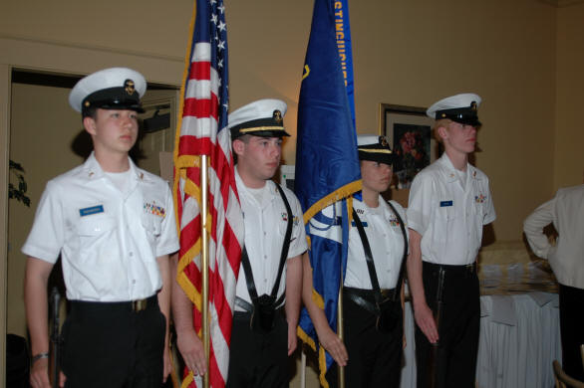

College Credits for Cadets 2020/21 with our UCCS Young Leaders Program
Check out the 3 credits available for national
Youth Leadership Programs
with University of Colorado, Colorado Springs
Enrollee must have Senior status
PSC 1510 – Leadership for the Next Generation: Citizenship and Community Service
– 3 semester hrs. - $240
https://www.leadershipcredit.info/youngleaders/
10

Slide 11






NOW…go to this link on your laptop, iPad or smart phone.
For follow up information send us your comments and questions….
http://www.leadershipcredit.info/
education-needs-analysis/
11

Slide 12
YOUR RTG POC:
JROTC Instructors from USMC, Navy and USAF contact:
Jim Gomez
rtgap2020@gmail.com
www.leadershipcredit.info
1.210.552.0759
12

